Slide 1



TUCO Chair’s Scholarship
Director Development Programme

Slide 2

Welcome
Programme / Tutor Overview
Accreditation Overview
Questions

Slide 3



Who are we?
Salford Professional Development, we are a training and development subsidiary of the University of Salford. Established in 2012 we have build a reputation for delivering customised and flexible training programmes which range from 6-12 months or even bite sized 2-day training sessions.
The programme you are about to embark on is a perfect example of the work we do. During the next 30 minutes I will take you on a journey through the programme from what each day will bring, the tutors and ending with the accreditation.
There will be time at the end of the presentation to answer all questions.

Slide 4


TUCO Chair’s Scholarship Director Development Programme
The Directors Development Programme:
We aim to prepare new and aspiring directors to excel in their roles. The 5-day programme will visit each aspect of the role of the director with the support of our expert tutors you will leave armed with both theoretical and practical knowledge of what it takes to become a successful director.
Following the 5-day programme you will embark on a Chartered Management Institute Level 7 (Masters Level) accreditation in Strategic Leadership.

Slide 5

TUCO Chair’s Scholarship Director Development Programme
Learning outcomes:
Legal requirements – Understand the legal requirements Directors must fulfil within their organisation
Confidence – Build confidence amongst your peers in the board rooms and completing financial report tasks
Leadership – Learn how to lead a team to drive organisational success, drive good work culture and encourage diversity
Digital – Understand the current digital economy and how that can impact your organisation and develop organisational strategies that promote innovation and value.
Marketing – Gain knowledge around the importance of marketing and analyse competition

Slide 6
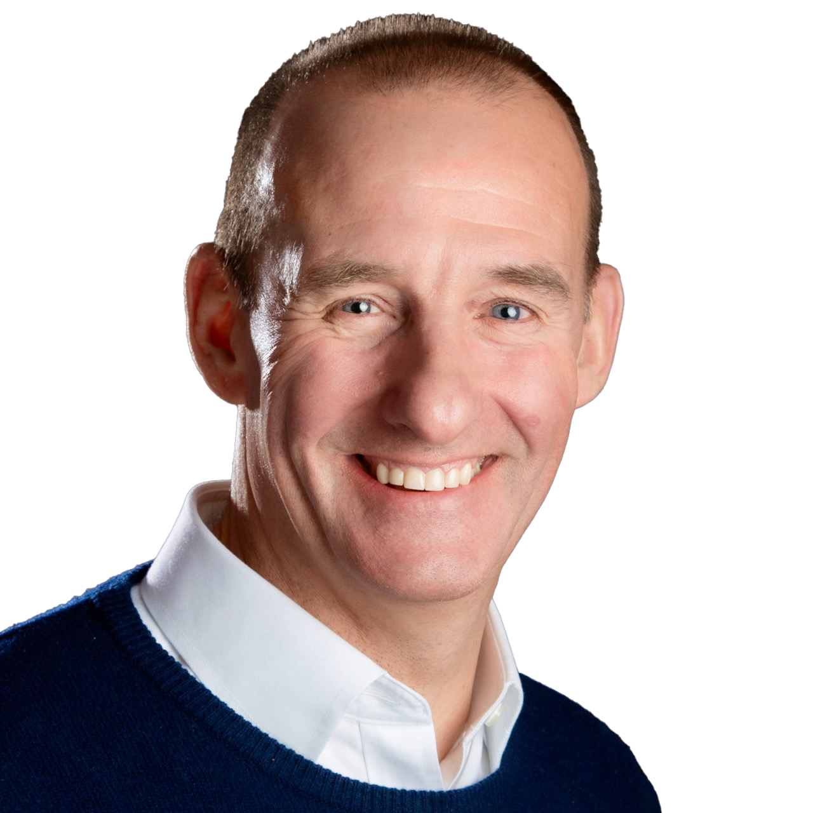
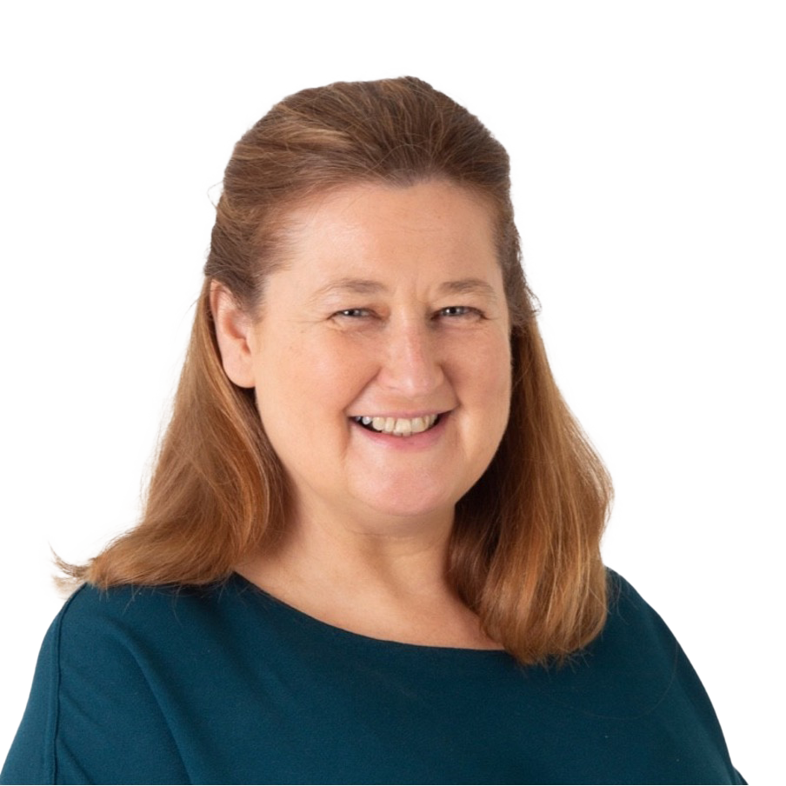

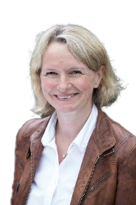
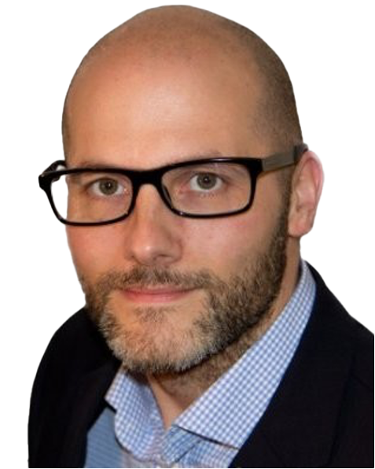
TUCO Chair’s Scholarship Director Development Programme
Day One
Leadership
Day Two
Governance
Day Three
Marketing
Day Four
Finance
Day Five
Strategy
Mark
Dyble
Kate O’Sullivan
Martin Corlett-Moss
Janet
Grant
Neil
Barrett

Slide 7
TUCO Chair’s Scholarship Director Development Programme
Day One Leadership
Day Two Governance
Day Three Marketing
Day Four Finance
Day Five Strategy
Meet the tutor
Mark Dyble
Agenda:
Mark brings over 25 years of practical commercial general management experience to his role as a business coach, having immersed himself in diverse positions within the corporate world both in the UK and overseas.
Mark's professional journey spans a rich variety of roles, from coal face supervisor to marketing controller, financial analyst, head of supply chain, management consultant, and managing director. This multifaceted background equips him with the versatility to navigate the complexities of the boardroom, the 'coal face', and everywhere in between.
As a seasoned business coach, Mark’s mission is to collaborate with the management teams of businesses, guiding them towards growth while unlocking their leadership and management potential.
Understand how today’s digital and global economy can change leadership and management practices
Learn how to manage performance and lead a high performing team
Drive a good work culture and encourage diversity
Use key coaching and mentoring skills to drive result

Slide 8
TUCO Chair’s Scholarship Director Development Programme
Day One Leadership
Day Two Governance
Day Three Marketing
Day Four Finance
Day Five Strategy
Meet the tutor:
Kate O’Sullivan
Agenda:
Kate is a motivational leader and coach with over 33 years’ experience in facilitating organisational design, development and transition for a broad range of companies, sectors and individuals. She holds a wealth of board experience and is especially adept at venturing constructive challenge and building strong relationships between the executives and non-executives of a board.
Kate is focused on helping companies understand that people are their greatest asset and in cultivating the environment and culture that enables leaders to raise their performance and deliver sustainable change.
Kate has a successful track record of working with a variety of stakeholders, to identify solutions to problems and implement strategies and operational plans - focused on the environment and culture that enables them to raise their performance and deliver sustainable change. She has a proven track record across a broad range of sectors and disciplines, developing strategic roadmaps for outstanding organisations including the University of York, Huntsman, ICI and British Rowing.
Review the corporate governance code and what does it mean to you
Understand the legal responsibilities as a director according to the law
Manage risk in your business
Know the different legal requirements for different types of organisations

Slide 9
TUCO Chair’s Scholarship Director Development Programme
Day One Leadership
Day Two Governance
Day Three Marketing
Day Four Finance
Day Five Strategy
Meet the tutor:
Martin Corlett-Moss
Agenda:
Martin has worked in the marketing industry for 31 years. For the first part of his career, he worked client-side for various major motor manufacturers and for the last 20 years has worked agency-side for a broad range of large and small clients.
As both Marketing Director and Managing Director, he has worked with clients at every level to implement marketing strategies and develop tactical campaigns across companies as diverse as Lloyds TSB, Mercedes, Scania and Harper Collins. Over the last 8 years, he has worked with companies throughout a wide range of industry sectors, from start-up entrepreneurs to larger, well-established brands.
He delivers training, coaching, and consultancy on every element of marketing, and has trained hundreds of companies in how to develop their marketing: what to do, what not to do, and how it all fits together.
Gain director-level knowledge of marketing
Learn the best practices and effective theories
Topics will include brand development and stakeholder communications
Delegates will work in group workshops and practical sessions

Slide 10
TUCO Chair’s Scholarship Director Development Programme
Day One Leadership
Day Two Governance
Day Three Marketing
Day Four Finance
Day Five Strategy
Meet the tutor:
Janet Grant
Agenda:
Janet qualified as a Chartered Accountant with Ernst and Young and has over 20 years of experience in senior management and finance director roles for recognised retailers such as WH Smiths and Littlewoods. She then followed her passion for developing people by becoming a leadership development trainer and resilience coach, working with a wide range of companies including the NHS, BAE Systems, marketing agencies and housing associations.
Janet supports not-for-profit organisations and currently acts as a Governor for the Trafford College Group, a Trustee and Treasurer for Home-Start Trafford, Salford and Wigan plus a business mentor with the Manchester Business Growth Hub.
Janet is a member of the Institute of Chartered Accountants (ICAEW), the Association of Coaching (AOC) and the Institute of Leadership and Management (ILM). She is also an accredited practitioner for the Thrive RQi resilience programme plus trained in the Drake P3 behavioural profiling system.
Understand financial legal responsibilities
Review common financial reports and statements
Be able to assess basic financial ratios to understand the health of an organisation
Learn how to raise funding and use/manage debt to the organisation’s advantage.
Assess the risks and opportunities that effect your finance team

Slide 11
TUCO Chair’s Scholarship Director Development Programme
Day One Leadership
Day Two Governance
Day Three Marketing
Day Four Finance
Day Five Strategy
Meet the tutor:
Neil Barrett
Agenda:
Neil Barrett is an experienced strategist with over 30 years working at the intersection of analysis, planning and organisational change. He currently leads on Strategy and Analytics at the University of Salford, overseeing a team of planners, analysts and researchers to deliver institutional strategy, risk management and performance improvement.
Prior to his work in higher education, Neil spent nearly two decades as a strategy consultant, supporting senior leaders across central government, policing, health, transport, and banking to make evidence-based decisions, manage risk and deliver transformation. He has designed and implemented strategies, analytics platforms and assurance frameworks that help organisations navigate uncertainty, improve outcomes and achieve their ambitions. Drawing on this wide experience, he brings a pragmatic, systems-thinking approach to strategy development, underpinned by deep expertise in operational research, predictive analytics and performance management.
Understand the language and dominant concepts in strategy
Ability to carry out broad and deep strategic analysis
Insight into strategy, success and strategic change goals short and medium term
Knowledge of strategic change frameworks
Strategy toolkit to be used for the future

Slide 12

TUCO Chair’s Scholarship Director Development Programme
Assignment | Assignment Requirement | Word Count
Strategic Management Project | Learning Outcome 1 – Know how to develop a strategic management project. | 4000 - 4500
Project Report | Learning Outcome 2 – How to conduct a strategic management project.
Developing Organisational strategy | Learning Outcome 1 – Understand how to develop strategy. | 3500 - 4000
Strategy Document | Learning Outcome 2 – Know how to develop strategy.
Leading Strategic Change | Learning Outcome 1 – Understand the scope and context of strategic change. | 4000 - 4500
Proposal for Change | Learning Outcome 2 – Know how to propose a strategy for leading strategic change.
Marketing Strategy | Learning Outcome 1 – Understand the context in which a marketing strategy is developed. | 3500 - 4000
Marketing Report / Strategy | Learning Outcome 2 - Know how to develop a marketing strategy.
Personal and Professional Development for Strategic Leaders | Learning Outcome 1 – Understand approaches for personal and professional development. | 3500 -4000
Reflective Review and PDP | Learning Outcome 2 – Know how to develop as a strategic leader through personal and professional development.
Mandatory Unit
Accreditation:
CMI Level 7 Certificate in Strategic Management and Leadership Practice
Successful completion of the 5-day programme you will progress onto the Accreditation element of the programme.
On the 7th Jan 2026 you will be invited to attend the accreditation where an assessor will go through the available modules and the expectations for each element of the accreditation process.
The basic assignment outline is one mandatory unit followed by one of the optional units:
Choose one optional unit

Slide 13

TUCO Chair’s Scholarship Director Development Programme
Questions?

